Slide 1
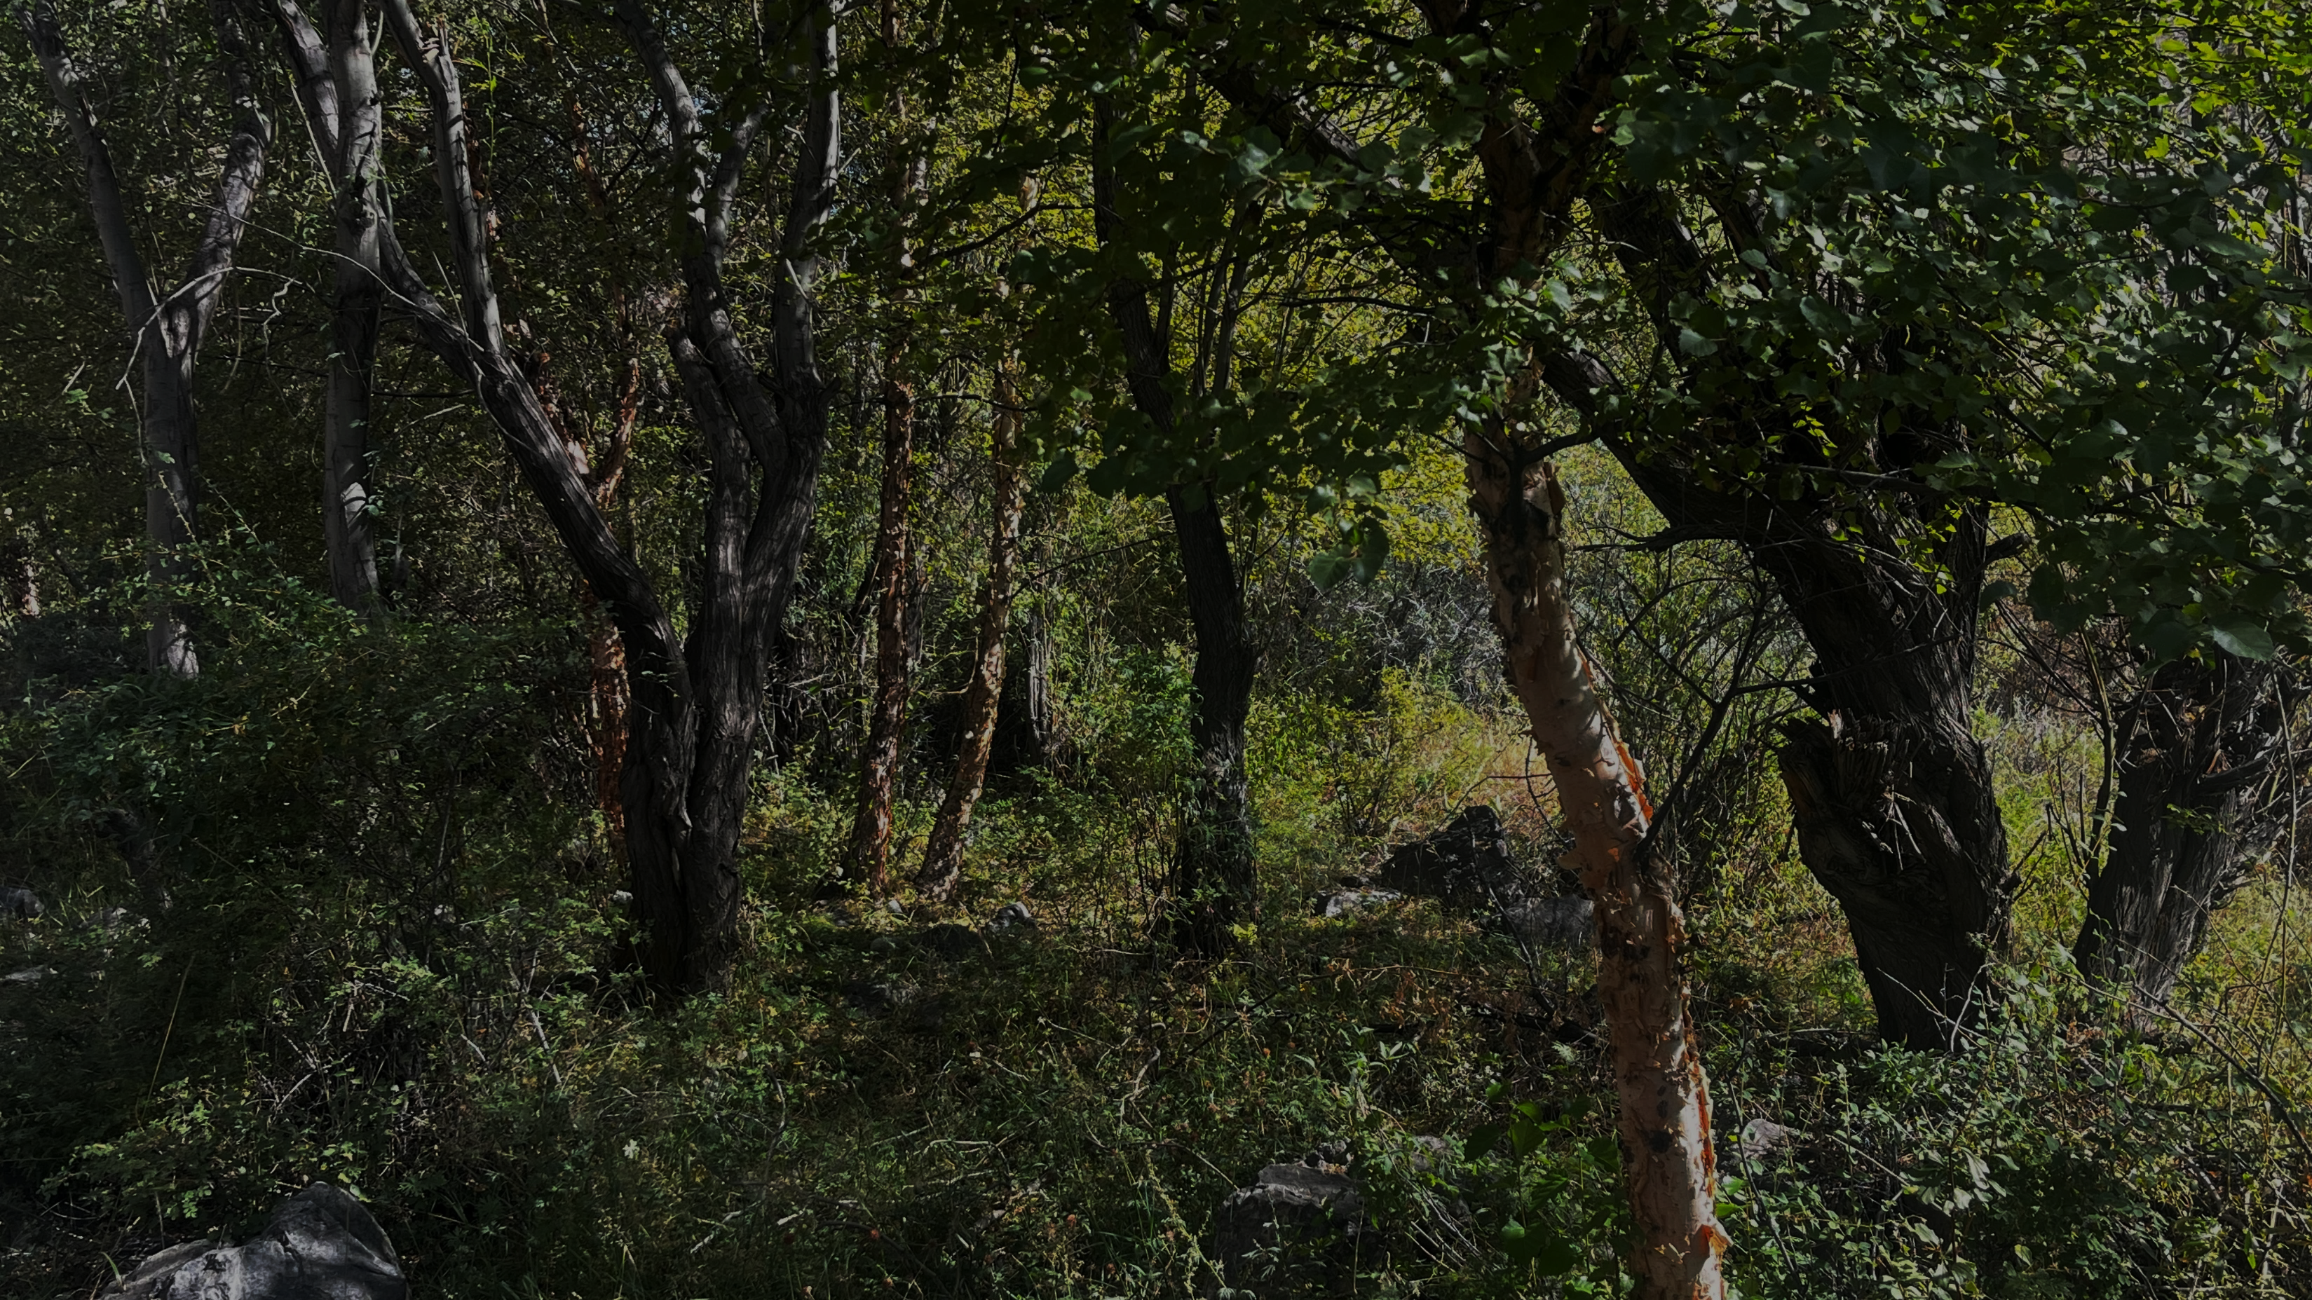
ECO-EVOLUTIONARY DYNAMICS & LIFE HISTORIES
Does the fast slow continuum adequately capture life-history variation across taxa, or do we need multiple axes of life-history strategy?
Group 1: Sifakakis Stylianos, Björklöf Juulia, Varga Luca Anna, Flašková Kateřina
Notes:
Every organism is part of a constantly changing story, shaped by the environment it lives in and the evolutionary pressures it faces. Eco-evolutionary dynamics and life histories explore how these interactions unfold over time, influencing how species survive, reproduce, adapt, and shape the world around them.

Slide 2
Does the fast slow continuum adequately capture life-history variation across taxa, or do we need multiple axes of life-history strategy?
Notes:
To answer the question, we have to understand certain dynamics that are present in nature. We will try to explain how they occur, and how different changes can affect, and reshape species.

Slide 3
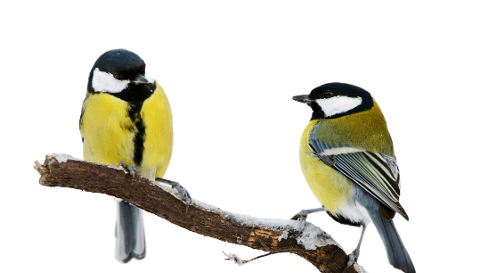
WHAT ARE ECO-EVOLUTIONARY DYNAMICS?
Photograph from Bildagentur Online/McPhoto-Rolfe/Alamy
Notes:
To begin with, we need to understand what eco-evolutionary dynamics are. This term describes interactions between ecology and evolution occurring on contemporary time scales. This means that if evolution can happen at the pace of ecology, changes to either one, will affect the other. For example, ecological differences can cause trait evolution over years, and evolution can shape ecological patterns and processes over long-time scales (such as photosynthesis); however, short-term evolutionary changes can also affect ecological processes under certain conditions. This is what weaves ecological and evolutionary dynamics together in contemporary times, ultimately defining eco-evolutionary dynamics.
Additionally, we have to understand what is Life History Theory.

Slide 4
LIFE HISTORY
Notes:
Life history theory explains that every individual organism goes through a cycle: it is born, survives, develops, possibly reproduces, and eventually dies. An organism's life history is the specific pathway it follows across its lifespan.

Slide 5
LIFE HISTORY
Life history traits
Notes:
Life history traits are traits that relate to the timing and occurrence of each stage, key events across the lifecycle. Here are some examples of different traits across multiple species:

Slide 6
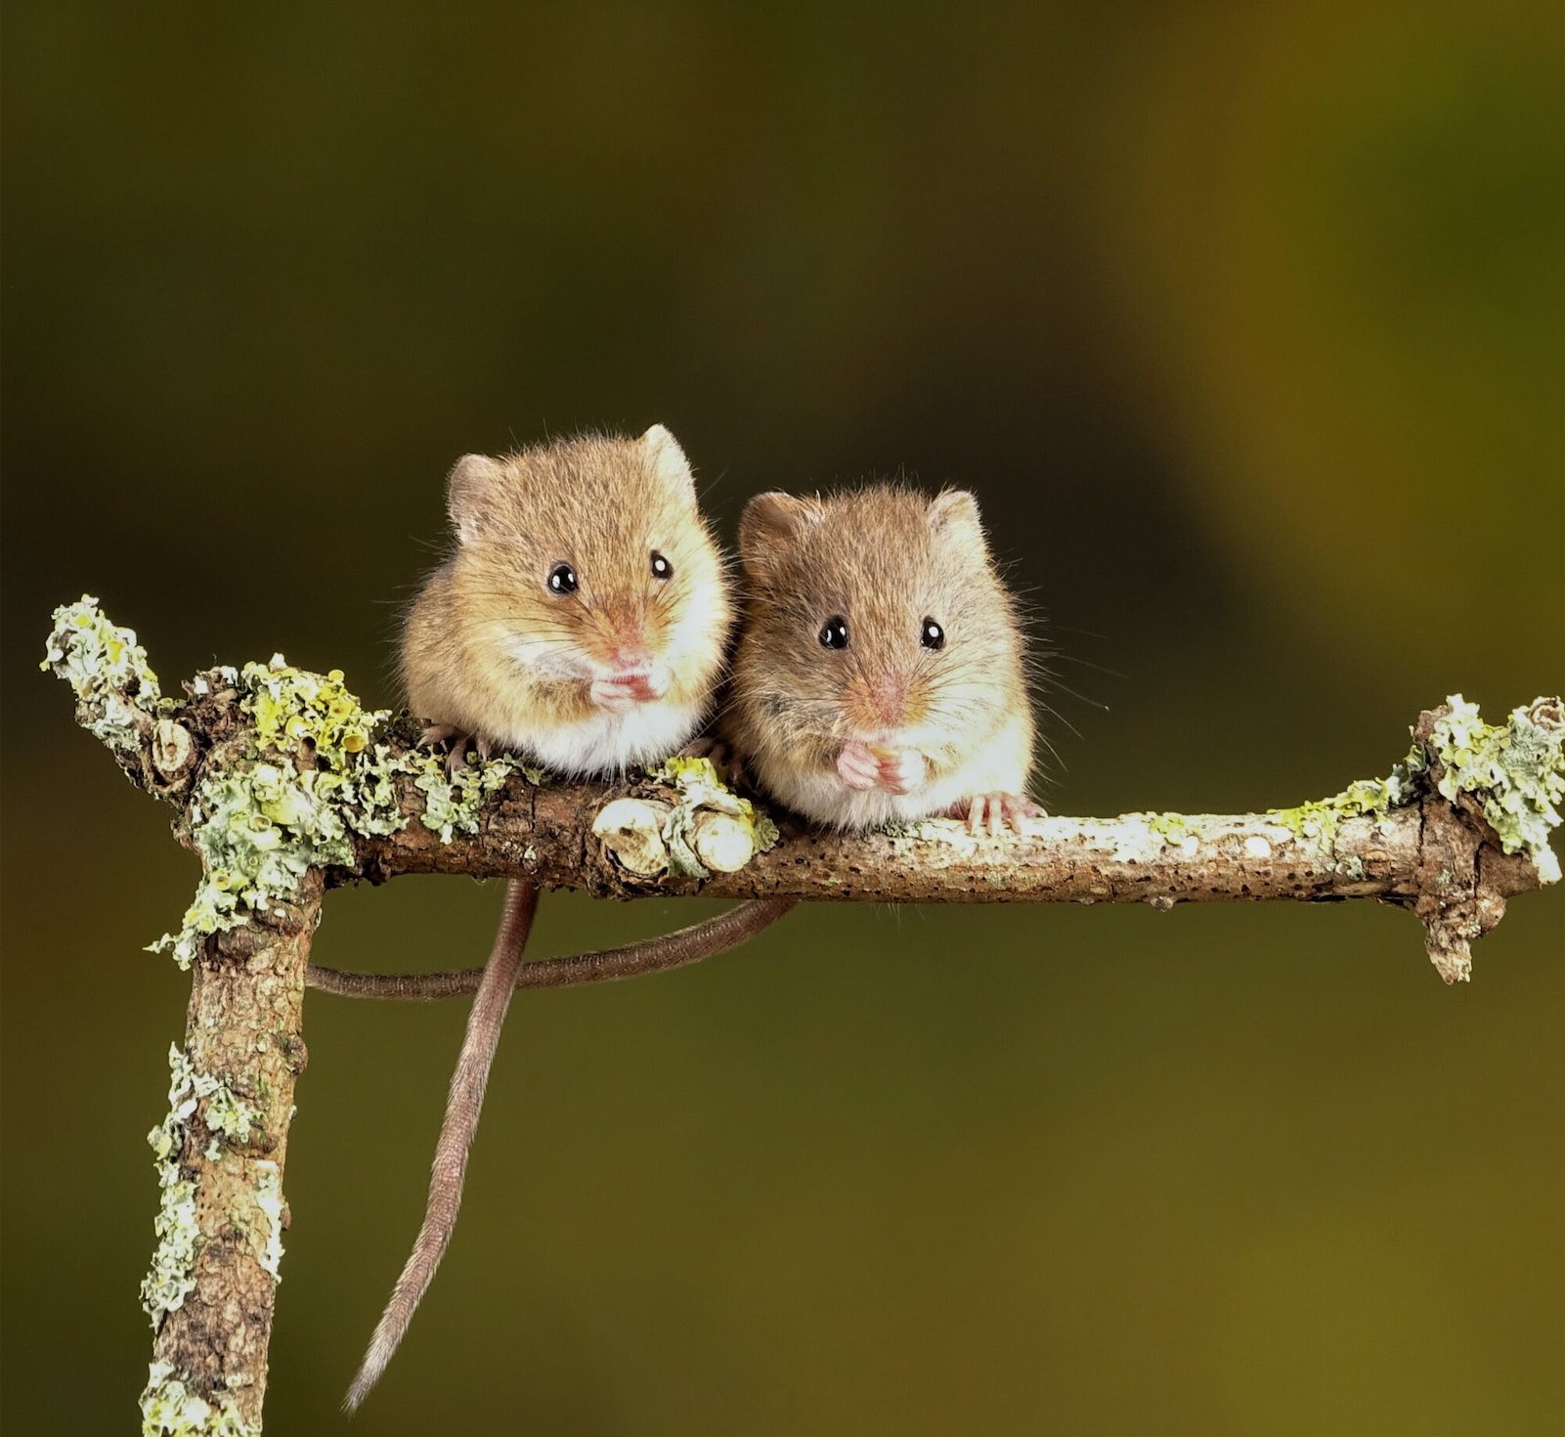
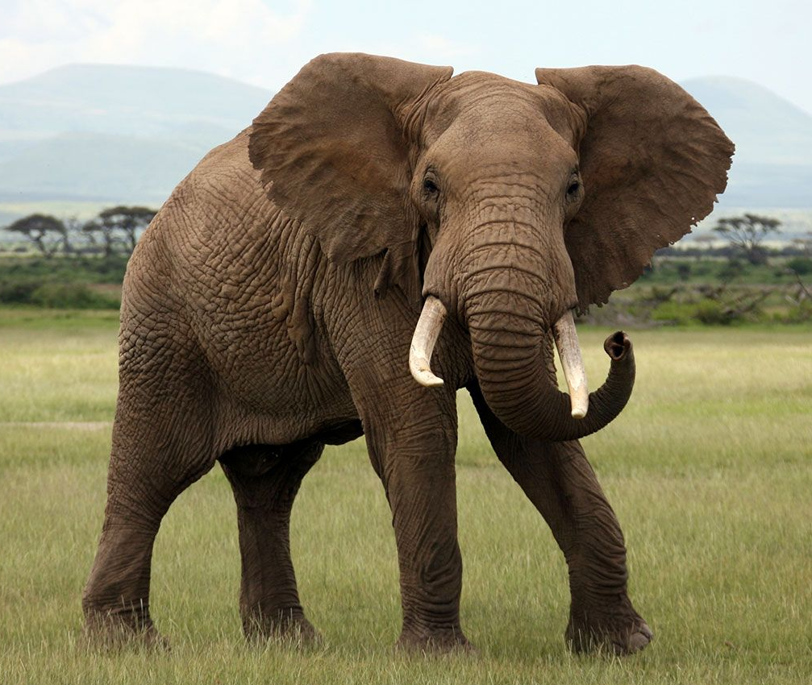
Age and size at maturity
American Pest (2022)
Britannica
Eurasian harvest mouse (Micromys minutus)
African bush elephant
(Loxodonta africana)
Notes:
Age and size at maturity: How old and large an organism is when it begins reproducing. For instance, the Eurasian harvest mouse reaches maturity in just 5–7 weeks, is 55–75 mm long, and weighs 4–11 grams, whereas an adult male African bush elephant reaches maturity at 12–20 years, stands at 3 meters tall at the shoulder, and weighs around 6 tons.

Slide 7
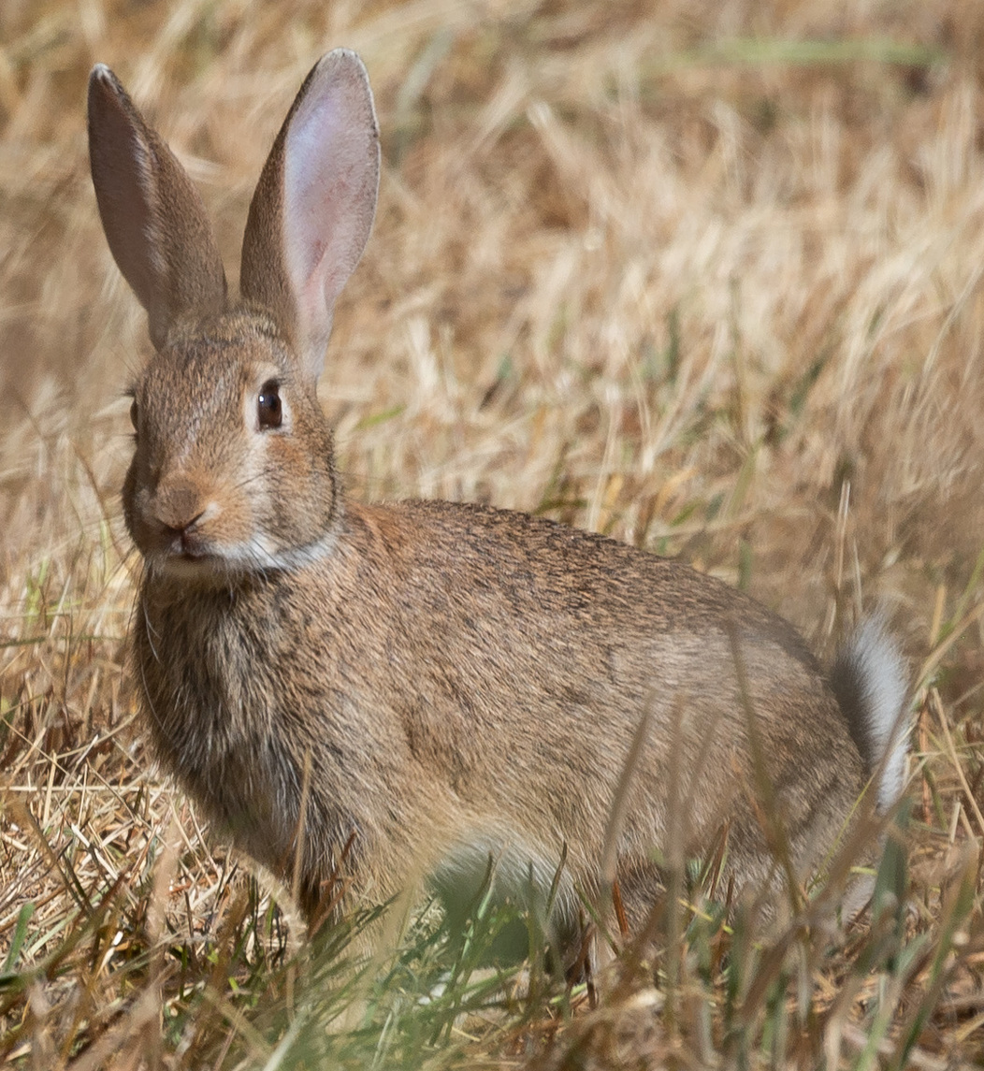
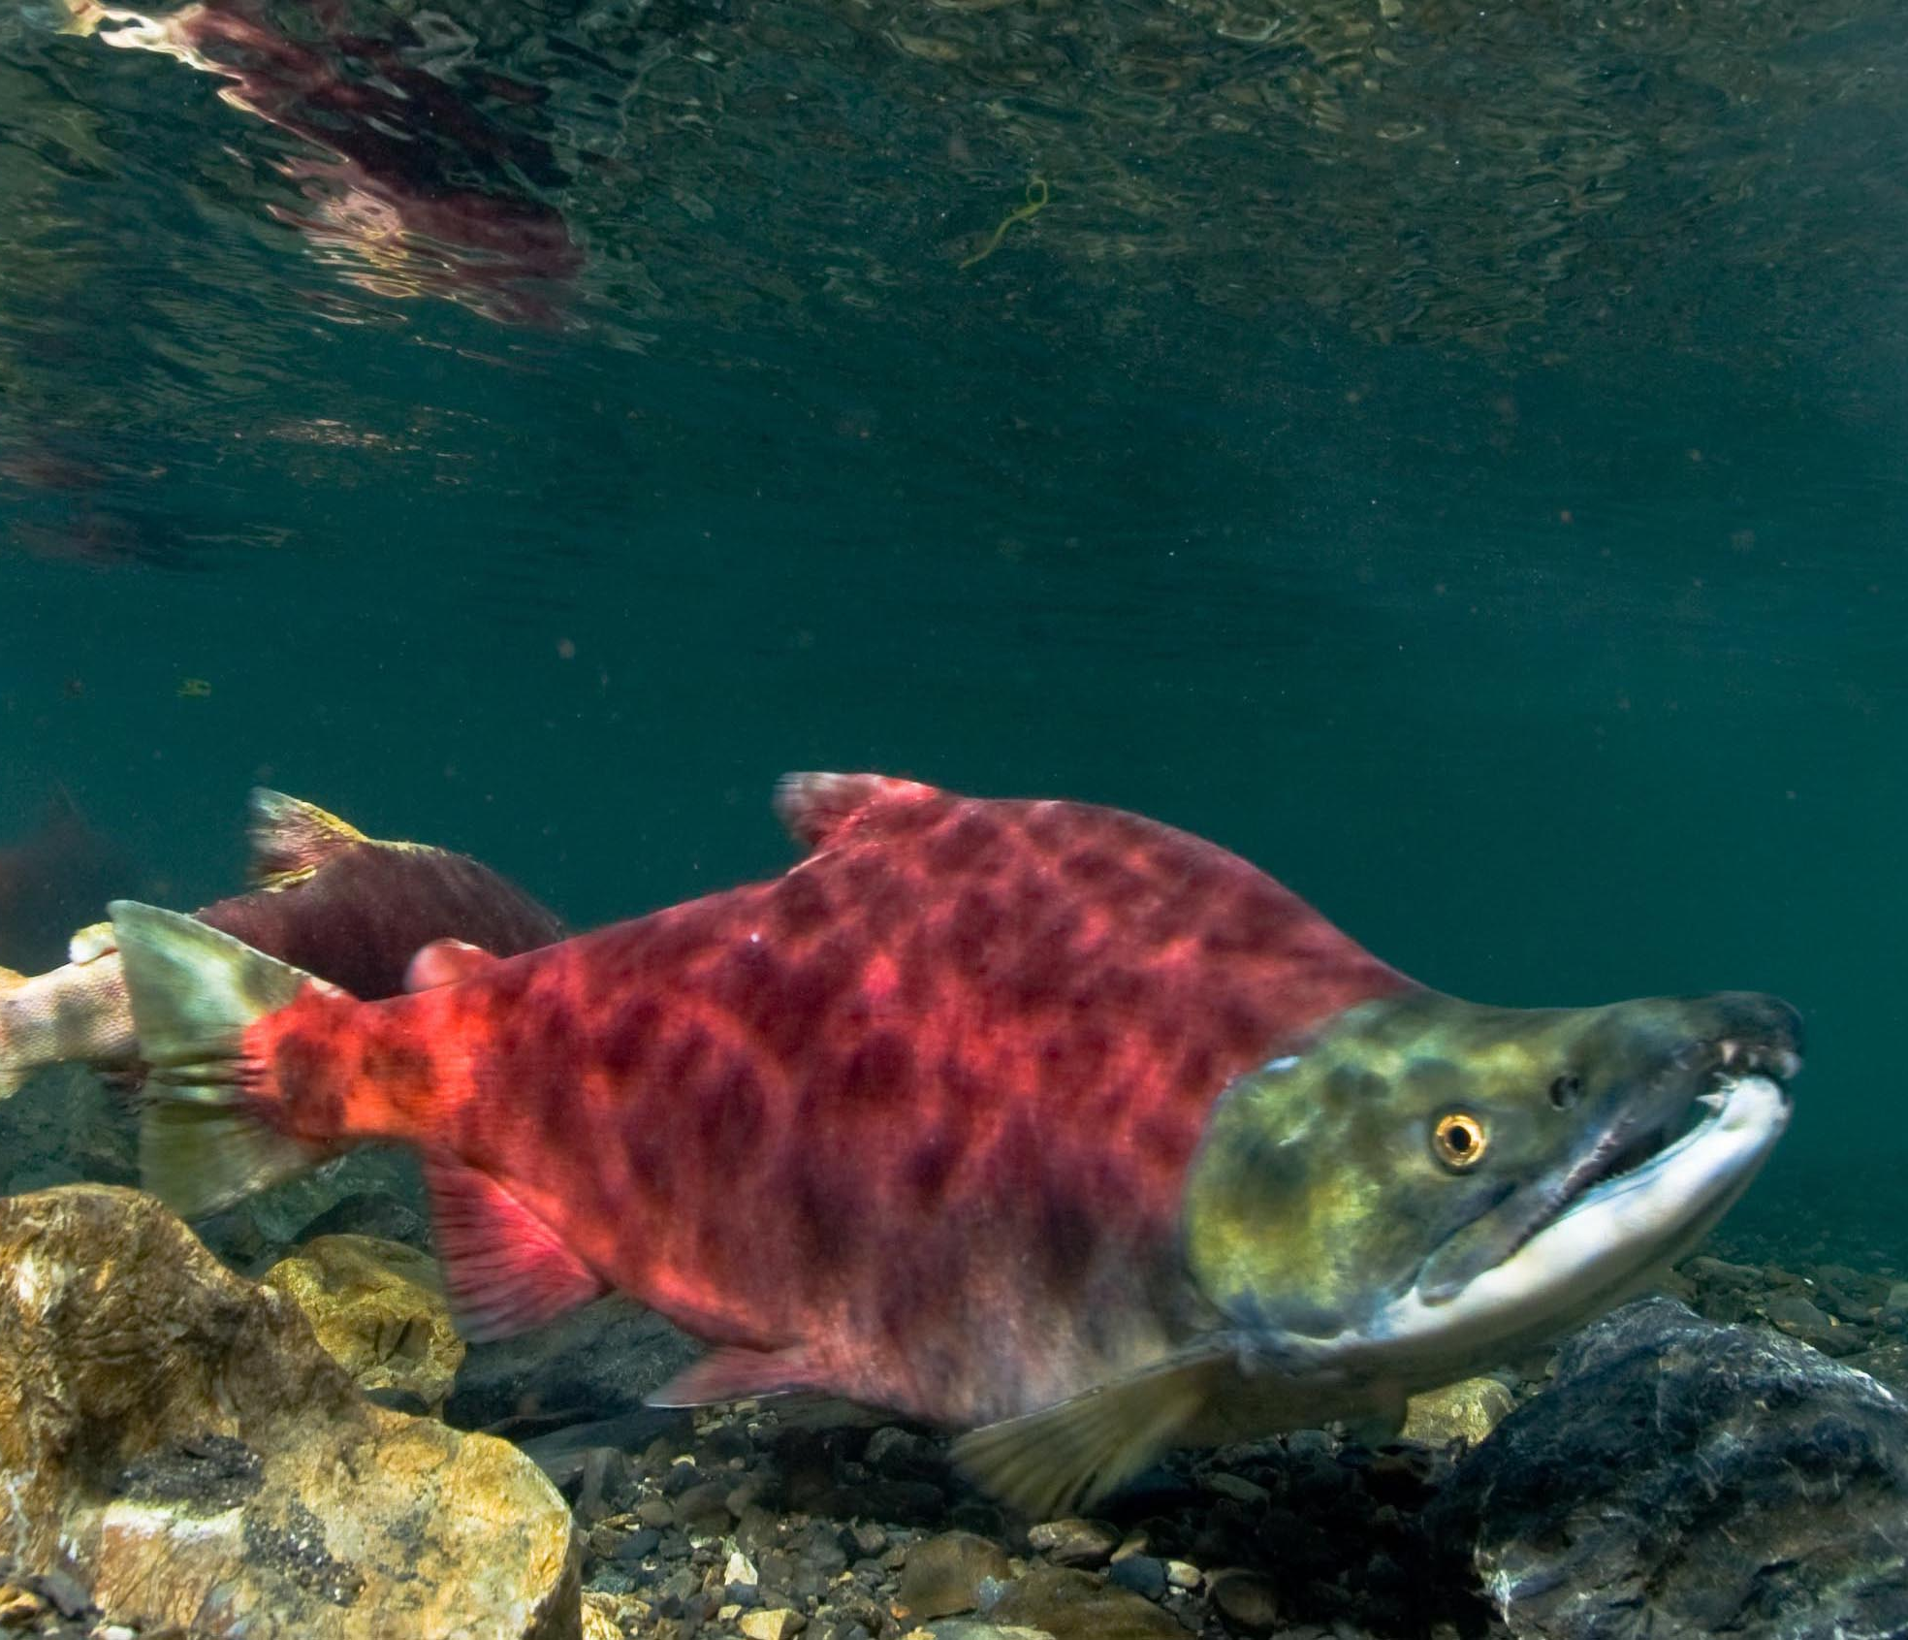
Parity
Wikipedia
euqirneto / Wikimedia Commons (CC BY 4.0)
Sockeye salmon
(Oncorhynchus nerka)
European rabbit (Oryctolagus cuniculus)
Notes:
Parity: This refers to reproductive frequency. Semelparous species, such as Pacific salmon, reproduce only once in their lifetime and die shortly after. In contrast, iteroparous species, like the European rabbit, reproduce multiple times.

Slide 8
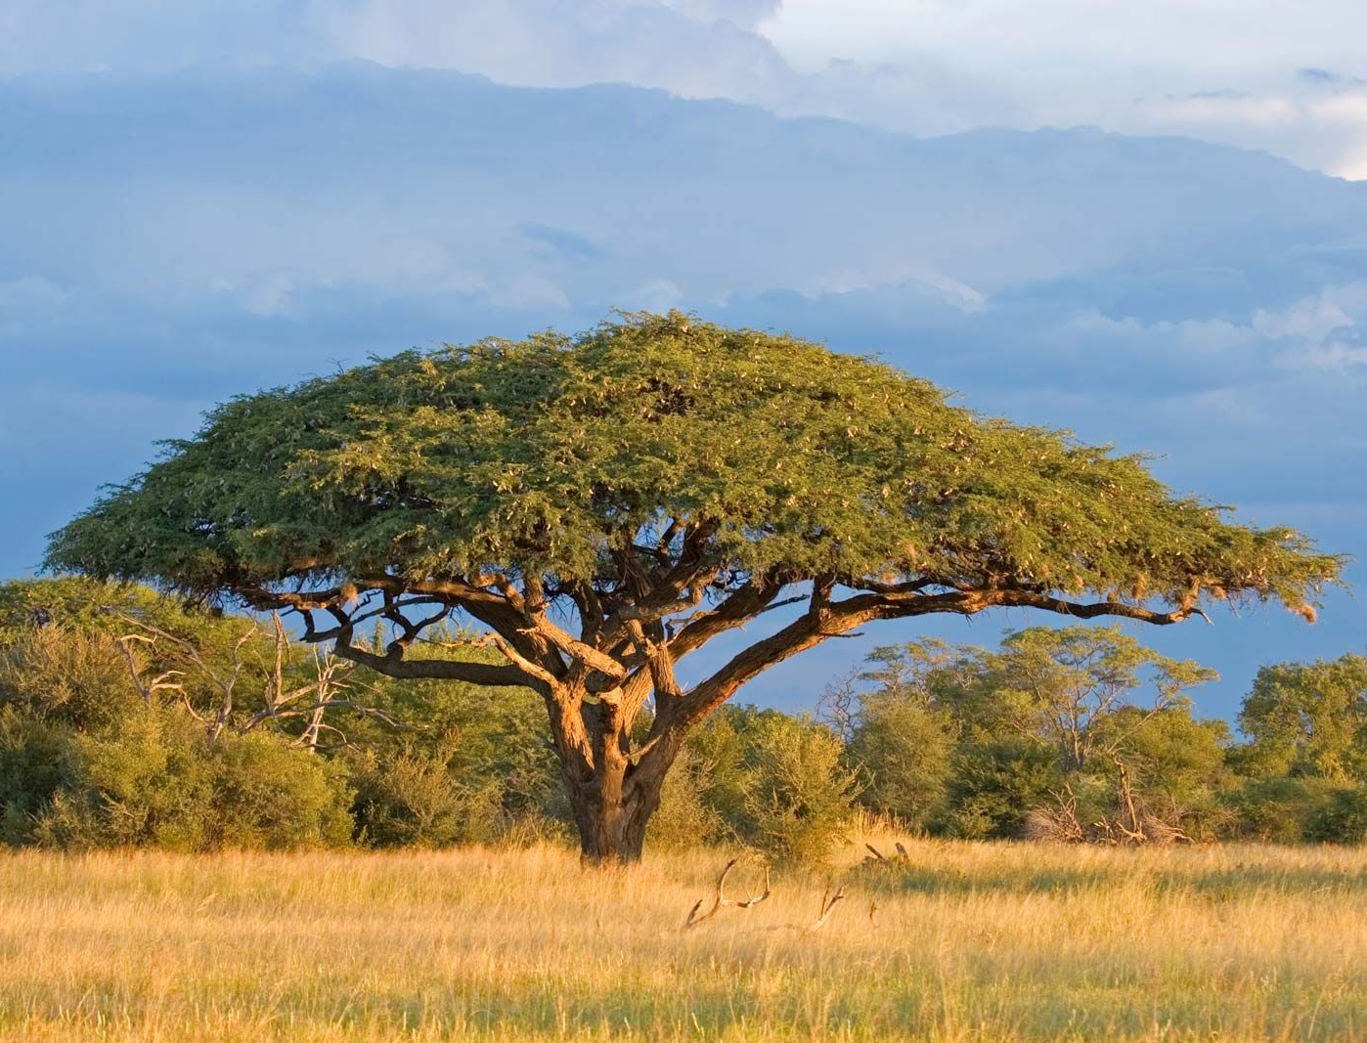
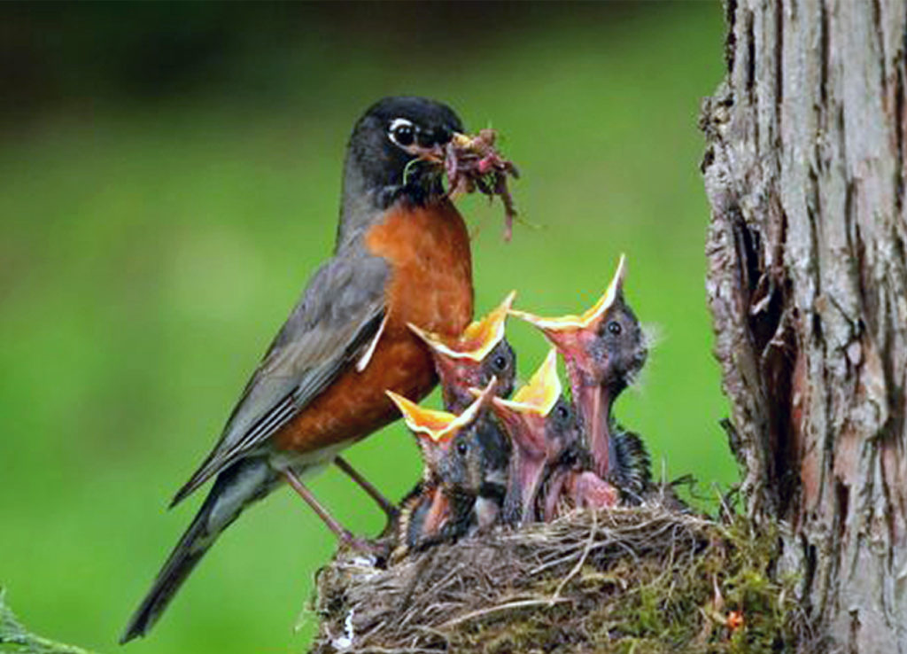
Parental investment
Britannica
Via Mr. Canary Company (Odell, Mom, Mom, MOMMM!, 2020)
Acacia tree on a savanna in Zimbabwe.
American robin
(Turdus migratorius)
Notes:
Parental investment: The amount of energy, time, and resources parents dedicate to feeding, protecting, and raising their offspring. The acacia tree spends minimum energy and time to parental investment, while American robin protects, feeds, and spend time to raise its offspring.

Slide 9
LIFE HISTORY
Life history traits
Life history strategies
Notes:
A life history strategy refers to the suite of reproductive and survival traits organisms adopt to maximize their evolutionary fitness in specific environments. Because resources and energy are limited, organisms face trade-offs. Allocating more energy to one trait, such as growth or reproduction, often comes at the direct expense of another, such as survival.“

Slide 10
Life history variation
Limited combinations
axis defined by the trade-off between allocation of time to reproduction and development versus survival
Notes:
Species cannot freely range across life history trait space.
Life history strategies are typically structured along an axis defined by the trade-off between allocation of time to reproduction and development versus survival. (Stott, I. et. al. (2024))
That’s why there are limited possibilities of trait combinations. To define the structure of variation of life history across taxa we can use the fast-slow continuum.

Slide 11
FAST-SLOW CONTINUUM
Two extremes:
FAST CONTINUUM SLOW CONTINUUM
Notes:
The fast-slow continuum is defined along two extremes that represent the trade-offs in life history variation.

Slide 12
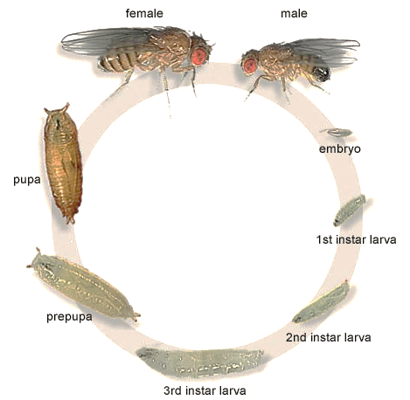
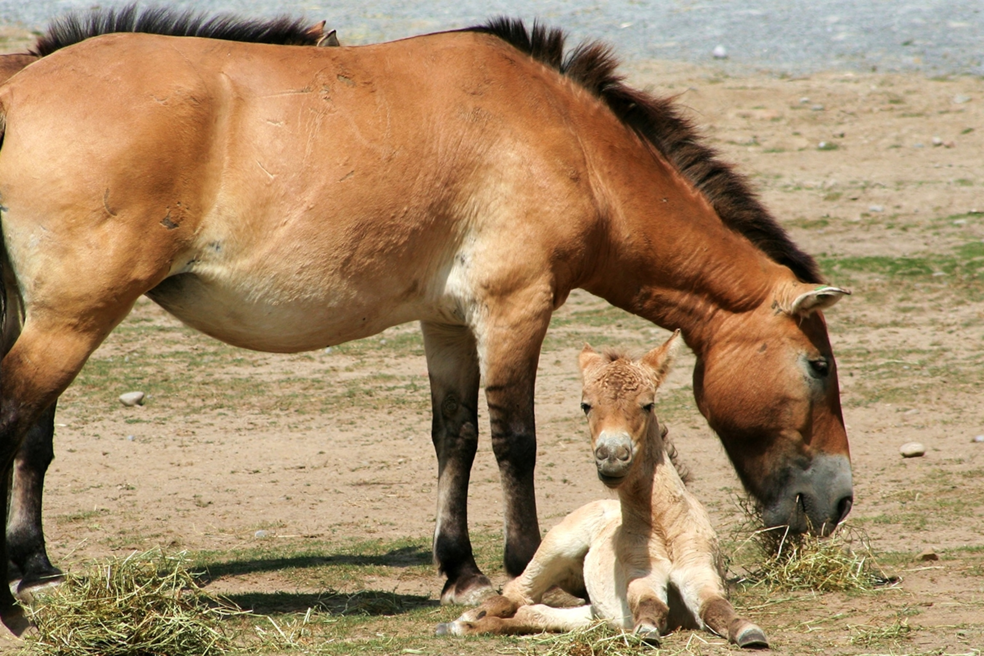
Fruit fly (Drosophila melanogaster)
Life cycle: 10-12 days in room temperature
Genetic studies
Przewalski horse
Age at maturity: 4-5 years old
Average lifespan: 20 years
University of Washington
kids.nationalgeographic.com
FAST CONTINUUM
Fast development
Earlier maturation
Earlier reproduction
More offsprings
Shorter lifespan
SLOW CONTINUUM
Slower development
Later maturation
Later reproduction
Less offsprings
Longer lifespan
Notes:
On one side is the A) fast continuum – defined by rapid growth, high reproduction and shorter lifespan. As an example, we can look at the fruit fly, it has a life cycle of 10 to 12 days in room temperature.
On the other side is the B) slow continuum – represents organisms with slow growth, long life span and lower reproduction. One example of species that is categorized as slow species is Przewalski horse, with age at maturity at 4 to 5 years old and lifespan in captivity of around 20 years (it has been only studied in captivity so far)

Slide 13
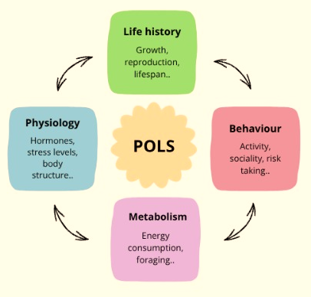
PACE-OF-LIFE SYNDROMES
Notes:
PACE OF LIFE SYNDROMES
Another way to identify the variation across taxa and expand the fast-slow continuum is pace of life syndromes (POLS). It takes the idea of fast-slow continuum a step further. Fast-slow continuum mainly focuses on life history traits such as growth, reproduction and lifespan. POLS suggests that life history traits may also be connected to other characteries, such as behaviour, physiology and metabolism.
For example, animals with faster pace of life might be more active and take more risks when searching for food. Animals with slower pace of life might behave more cautiously. These traits may be connected because they are part of the same life strategy.
However, these connections are not similar for all the species. The strategy of the animal depends on the environment it lives in, and the traits doesn’t always change together. For example, a brave animal doesn’t necessarily reproduce earlier or have a shorter lifespan. There are also differences between individuals because they can live in different environments and face different risks.

Slide 14
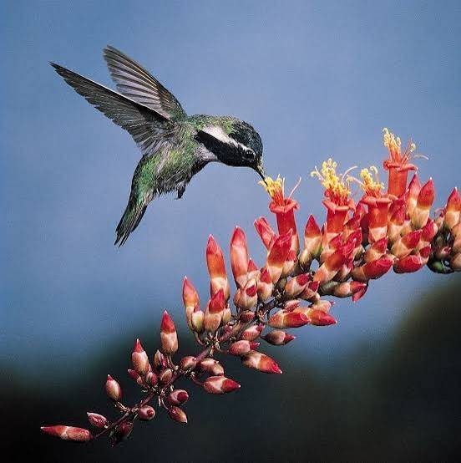
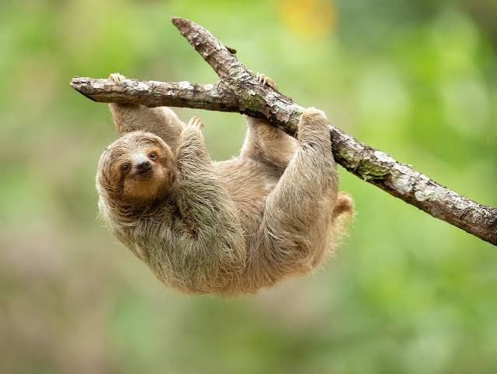
Britannica
a-z-animals
Notes:
Interesting comparison could be a hummingbird and a sloth. Hummingbirds are very active and use a lot of energy and live shorter than sloths that have less active lifestyle and low energy consumption.

Slide 15
Is the fast-slow continuum enough to define variation of life history across taxa?
Dominant axis
Broad picture in tetrapods
Vascular plants and corals
Few studies in invertebres (except insects)
Notes:
With the pace-of-life syndromes we gat back to the question, if the fast-slow continuum is enought to define variation of life history variation.
Fast slow continuum is recognized as the dominant axis for explaining life history, but it is increasingly more evident that it is insufficient for providing the full picture and it is required to have more than one axis of life history variation.
It provides broad picture for tetrapods (mammals, birds…), vascular plants and corals, but there is lack of studies and evidence supporting its applicability in invertebrate, except insects.

Slide 16
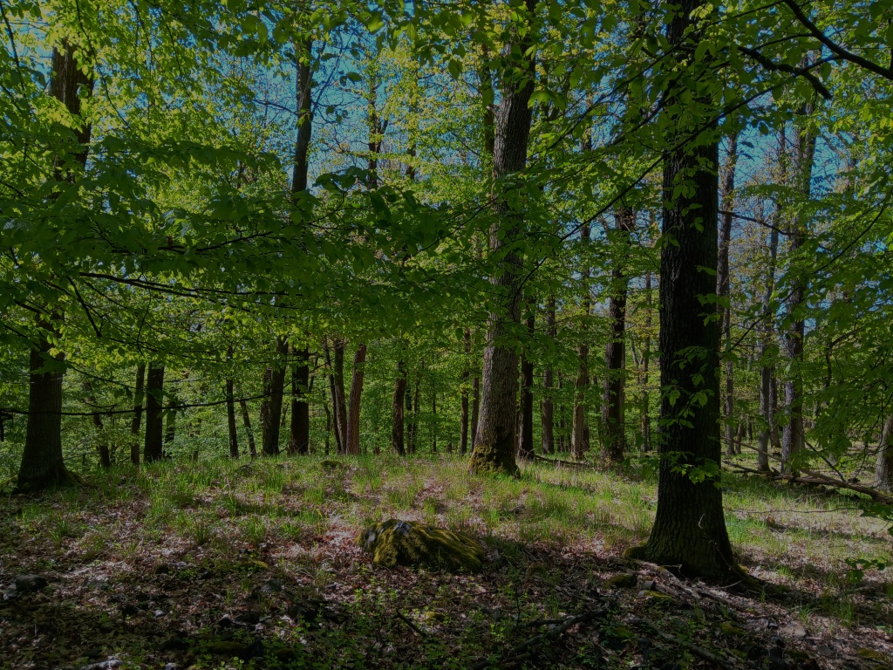
Many organisms fall out of fast-slow continuum predictions
→ multiple axis are needed
Developmental patterns
Reproductive patterns
www.lesaktualne.cz
Notes:
Many organisms fall out of its predictions, for example marine turtles and most trees.
If we look at the trees, we see that they have longer life span, mature late, and grow slower but also have high reproduction. If it followed fast-slow continuum prediction reproduction would be lower.
Growing evidence suggests the existence of multiple different axis along developmental and reproductive patterns

Slide 17
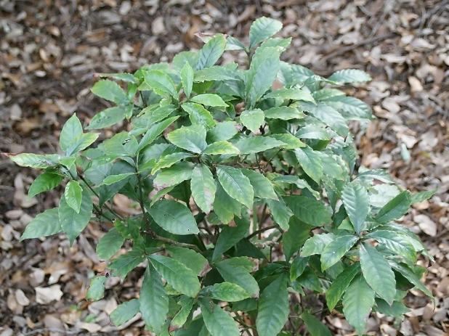
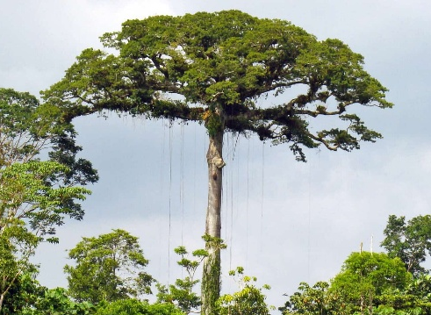
High vs. low recruitment rates (stature–recruitment’ axis)
→ rate of the addition of new individuals to a defined segment of a population
Psychotria horizontalis (picture: Wikipedia) – high recruitment rate (low juvenile mortality)
Ceiba pentandra (kapok tree) (picture: Ceiba foundation) – low recruitment rate (high juvenile mortality)
Notes:
One of the possible axes is the High vs. low recruitment rates (stature–recruitment’ axis)
= defined as the addition of new individuals to a defined segment of a population
As an example we can take a look at these two tropical trees.
The high recruitment rates end is represented by wild coffee plant, creates a lot of seeds, mortality of its juvenile stage is low and reproduces after reaching 1 to 3 meter tall. After that its survival and growth decline.
On the other end, we see the kapok tree, this tree also creates a lot of seeds, but the mortality of juveniles is high, because it needs direct sunlight to grow and develop. Once it reaches adulthood, survival rate and growth rapidly increase.
If this was according to fast-slow continuum, mortality of juveniles in wild coffee would be high, and the other way around for the kapok tree.

Slide 18
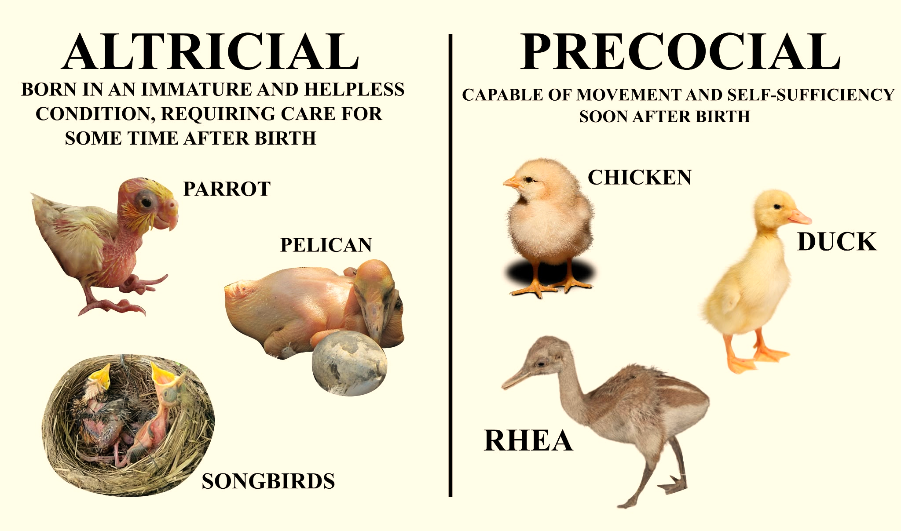
Precocial offspring
Altricial offspring
vs.
Wikipedia
Wikipedia
Notes:
An other axis is Altricial Vs precocial offspring
The difference precociality altriciality is most noticeable in birds
.
Precocial: the offsprings are capable of movement and self sufficiency stood after birth. They are almost fully developed when born. Their eyes are open and they already have hair or down feathers. They aren't confined to nests. The parents energy goes into prenatal development, like the eggs of a precocial bird is higher in calories to help the chick develop inside the egg. Animals that have precocial offspring are ungulates, ducks and turkeys.
Altricial: The offsprings are born immature and helpless. They are often born naked, with no hair or down feathers. They are confined to nests or burrows. The parents energy goes into parental care after birth. Animals that have altricial offspring are passerine birds, rodents and humans
But the degree of development at birth isn't just black or white. It's more of a gradient. There is also semi-precocial and semi-altricial offsprings. Like the offsprings of parrots.
Another possible axes include for example: Semelparity vs. Iteroparity, Environmental and Plant Functional Axes, …

Slide 19
Conclusion: The fast-slow continuum works as the main axis for certain taxa, but we still need multiple different axis to define all of the variation across taxa.

Slide 20
QUESTIONS?

Slide 21
Resources
Salguero-Gómez, R. (2016). Article on plant life-history strategies. New Phytologist.
Les aktuálně. (n.d.). Jak duby snášejí klimatické extrémy.
National Geographic. (n.d.). Przewalski’s Horse.
Wikipedia contributors. (n.d.). Krytosemenné. Wikipedie.
Pacific Salmon - Wild Salmon Center
Rabbit facts | Mammals | BBC Earth | BBC Earth
American Robin: Facts, Diet, Habitat, Behavior & Identification Guide
European rabbit — Mammal Society
Elephant Facts | Mammals | BBC Earth | BBC Earth
Eurasian Harvest Mouse - Facts, Diet, Habitat & Pictures on Animalia.bio
Arnot, M. (2017). A Response to Gardner and Harrison: The Reasons for, and Implications of, Brexit from an Anthropological Standpoint. ResearchGate.
ScienceDirect research article. (2020).
Royal Botanic Gardens, Kew. (n.d.). Plants of the World Online: Taxon record.
Nature Communications research article. (2024). Nature Communications.

Slide 22
Resources
Stearns, S. C. (1977). The evolution of life history traits: a critique of the theory and a review of the data. Annual Review of Ecology and Systematics, 145–171.
Stott, I. et al. (2024). Life histories are not just fast or slow. Trends in Ecology & Evolution, 39(9), 830–840.

Slide 23
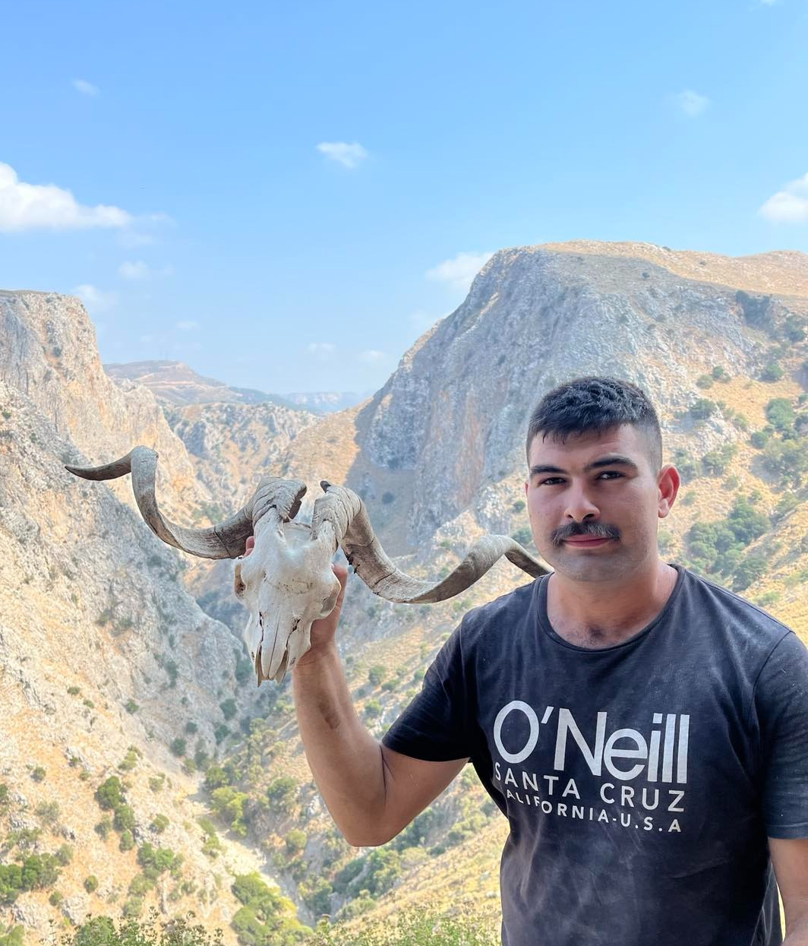
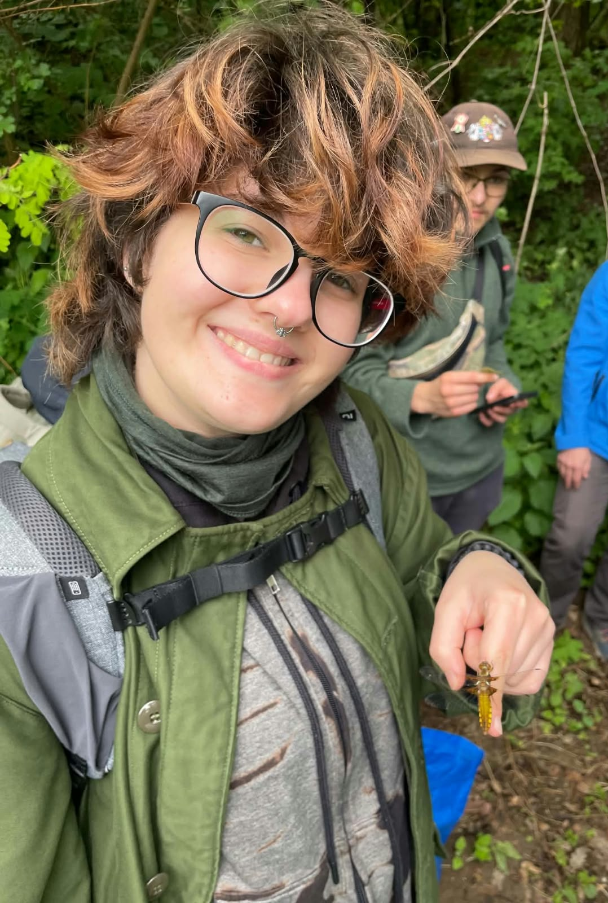
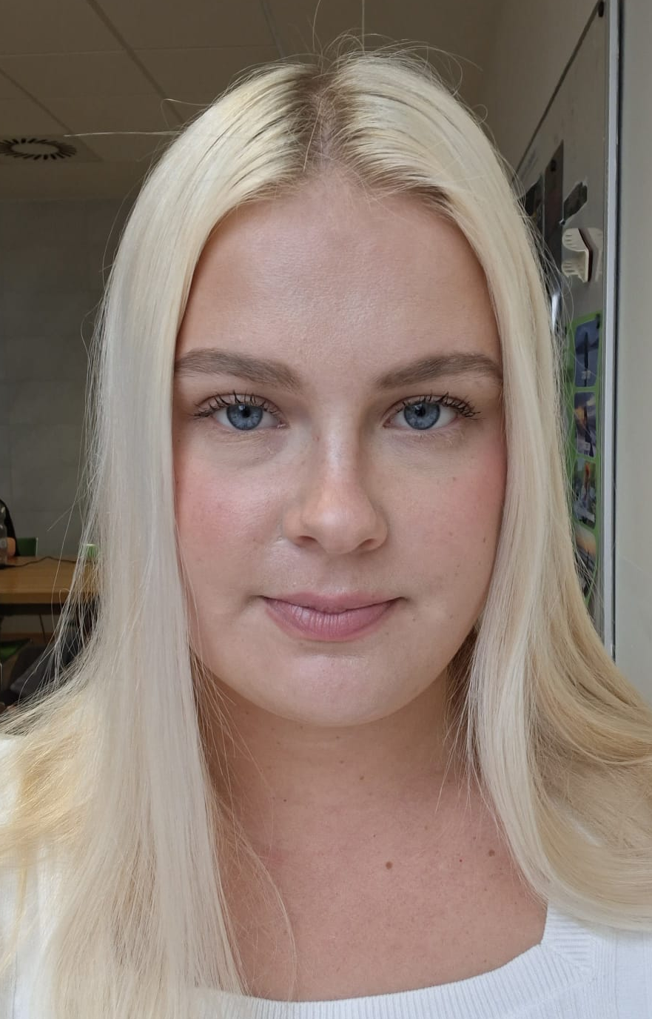
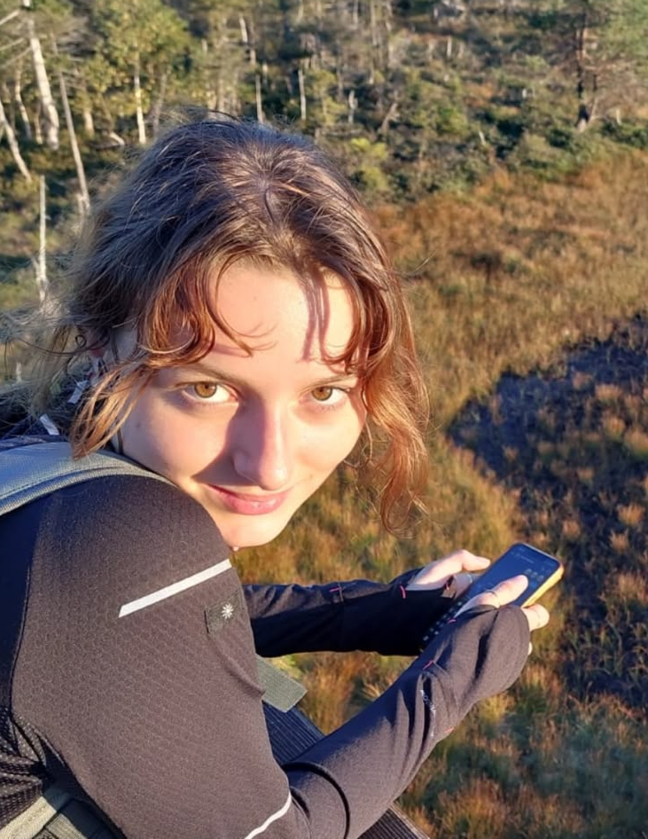
Contributions
Kateřina Flašková
Presentation and notes
Extract information
Presentating
Conseptualisation
Juulia Björklöf
Conseptualisation
Extract information
Presentating
Stylianos Sifakakis
Presentation and notes
Extract information
Presentating
Conseptualisation
Varga Luca Anna
Extract information
Presentating
Conseptualisation

